Slide 1
Python Arrays
DVT101 – Lecture 28
- By Dataverse Tutorials

Slide 2
What Are Arrays in Python?
Meaning of sequential data storage
Contiguous memory concept
Difference between list and array idea
Why arrays matter in data processing

Slide 3
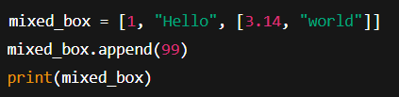
Python List as a Dynamic Array
Python list behaves like array
Supports mixed data types
Grows and shrinks dynamically
Easy to use for beginners

Slide 4
Key Properties of Python Lists
Dynamic typing
Dynamic resizing
Built-in utility functions
Flexible memory usage

Slide 5
Internal Working of Python Lists
Under-the-hood memory blocks
Index-based access
Dynamic reallocation strategy
Time complexity intuition

Slide 6
Limitations of Python Lists
High memory usage
Slower for numerical computation
Mixed type overhead
Not suitable for scientific workloads

Slide 7
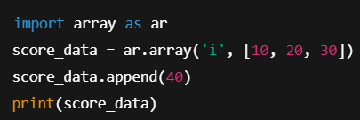
Python array Module (Homogeneous Arrays)
Stores same datatype only
Memory-efficient structure
Faster than list for numeric values
Ideal for large uniform datasets

Slide 8
Data Types in Python Arrays
Type codes concept
Integer, float, char, etc.
Memory size impact
Why type safety improves performance

Slide 9
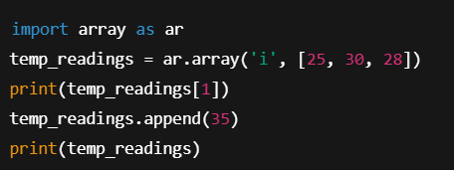
Core Array Operations (Concept)
Creating an array
Accessing elements
Adding new values
Removing values

Slide 10
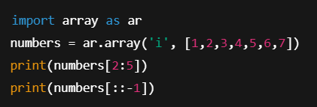
Indexing & Slicing in Arrays
Zero-based indexing
Forward & backward slicing
Range extraction
Reverse traversal concept

Slide 11
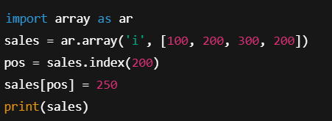
Searching & Updating Elements
Index search logic
First occurrence behavior
Reassignment updates
Use in real-time data editing

Slide 12
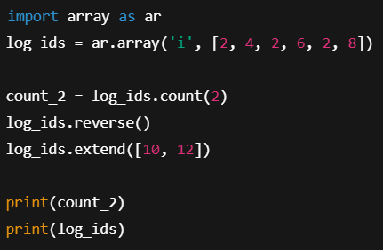
Advanced Array Operations
Counting elements
Reversing arrays
Extending arrays
Combining multiple sequences

Slide 13
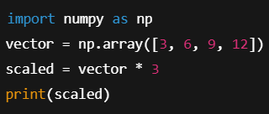
Why NumPy Arrays Exist
Need for high performance
Vectorized operations
Scientific computing requirement
Industry adoption

Slide 14
NumPy vs Python Array vs List
Performance comparison
Memory efficiency
Use-case suitability
Scalability factors

Slide 15
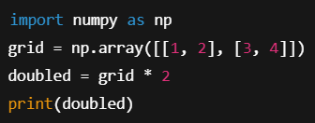
Multi-Dimensional Arrays
Matrix representation
Row & column concepts
Real-world modeling
Data science usage

Slide 16
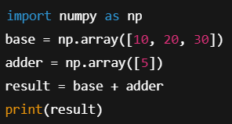
Broadcasting Concept in NumPy
Automatic shape matching
Element-wise operations
Speed advantage
Cleaner code logic

Slide 17
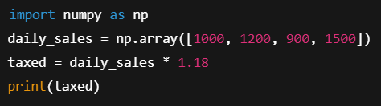
Real-World Industry Use Cases
Machine learning datasets
Image processing
Financial time-series
Scientific simulations

Slide 18
Common Mistakes with Arrays
Wrong datatype
Index out of range
Mixing list & array logic
Performance misuse

Slide 19
Best Practices
When to use list
When to use array
When to use NumPy
Optimization mindset

Slide 20
Career Perspective
Data Analyst usage
ML Engineer pipelines
Backend systems
Big data processing

Slide 21
Summary & Key Takeaways
Lists are flexible
Arrays are memory-efficient
NumPy is performance king
Choose wisely

Slide 22


